Slide 1




DIGITAL PORTFOLIO ​
NAME: ​R.TUSYAA
REGISTER NO: ​212402317
NMID: 626044B4374EAD79D1344DFFE1178444
DEPARTMENT: ​BCA
COLLEGE/ UNIVERSITY: ​A.M.JAIN COLLEGE

Slide 2

MY PORTFOLIO

Slide 3
AGENDA
​
Problem Statement​
Project Overview​
End Users​
Tools and Technologies​
Portfolio design and LAYOUT​
FEATURES AND FUNCTIONALITY​
RESULTS AND SCREENSHOTS​
CONCLUSION​
GITHUB LINK​

Slide 4
PROBLEM STATEMENT
Building a personal portfolio website that showcases skills, projects, and contact details in a modern, visually appealing, and interactive way. Many developers struggle to present their work effectively; this project solves that by creating a cyberpunk-inspired interactive portfolio.

Slide 5
PROJECT OVERVIEW
THE PROJECT IS A RESPONSIVE PORTFOLIO WEBSITE FOR R.TUSYAA, DESIGNED WITH A FUTURISTIC NEON THEME.
IT HIGHLIGHTS SKILLS, PROFILE, AND PROJECTS WHILE OFFERING SMOOTH NAVIGATION AND INTERACTIVE UI ANIMATIONS.

Slide 6
END USERS
RECRUITERS / HIRING MANAGERS – TO EVALUATE SKILLS AND PROJECTS.
Clients – to understand expertise before collaborATION.
PEERS & COMMUNITY – TO NETWORK AND EXCHANGE IDEAS.
SELF-BRANDING – TO MAINTAIN A PROFESSIONAL ONLINE PRESENCE.

Slide 7
TOOLS AND TECHNOLOGIES
FRONTEND: HTML5, CSS3, JAVASCRIPT
STYLING: GOOGLE FONTS (ORBITRON, SHARE TECH MONO), FONT AWESOME
UI ENHANCEMENTS: RESPONSIVE NAVIGATION, HAMBURGER MENU, SCROLL ANIMATIONS
DESIGN THEME: CYBERPUNK NEON AESTHETIC WITH GLOWING EFFECTS

Slide 8
Header: Name & tagline with neon glow.
Navigation: Sticky top menu with smooth scrolling & mobile-friendly hamburger menu.
Profile Section: Personal intro + profile image.
Skills Section: Grid layout of tech stack with icons.
Portfolio Section: Showcase of projects (Resume Builder, AI Chatbot, Portfolio Website).
Contact Section: Contact form + email & phone details.
Footer: Copyright & college email.
Extras: Scroll-to-top button, animated section reveals.
PORTFOLIO DESIGN AND LAYOUT

Slide 9
FEATURES AND FUNCTIONALITY
FULLY RESPONSIVE DESIGN (DESKTOP & MOBILE).
Smooth scroll animations on sections.
Interactive hover effects on portfolio and skills.
Working contact form (frontend) with plACEHOLDERS FOR BACKEND INTEGRATION.
SCROLL-TO-TOP BUTTON FOR BETTER USER EXPERIENCE.

Slide 10
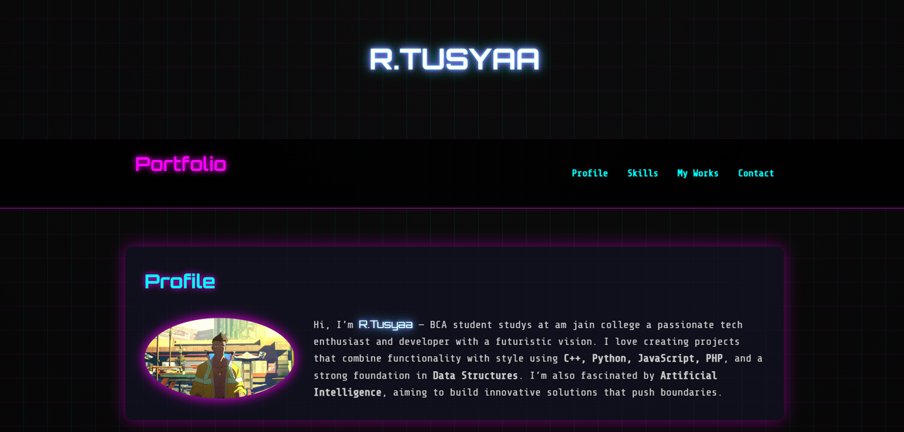
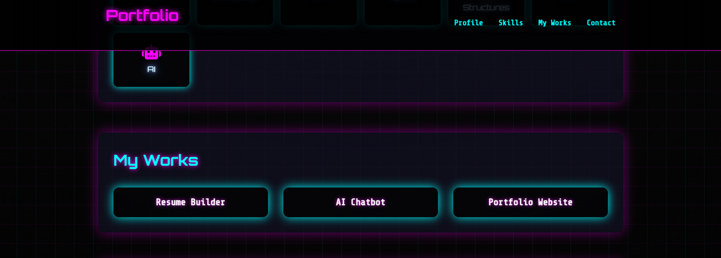
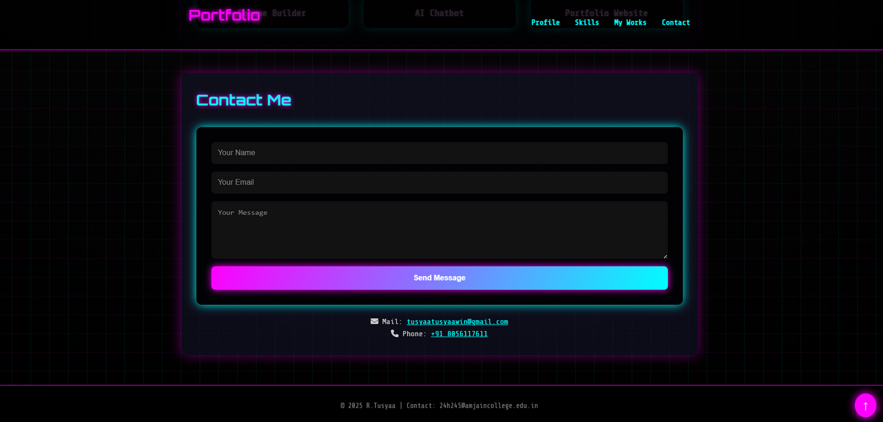
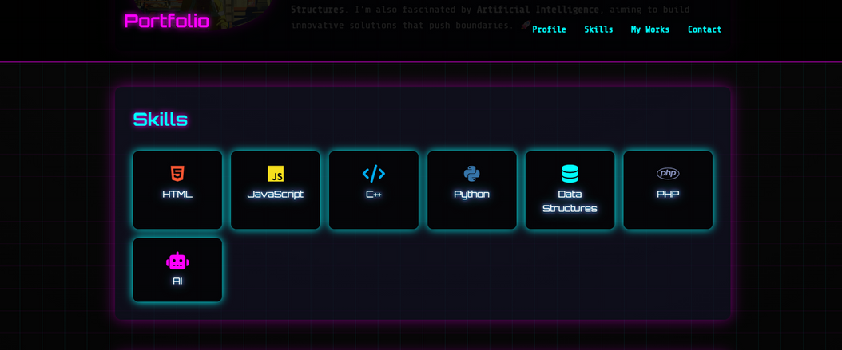
RESULTS AND SCREENSHOTS

Slide 11
CONCLUSION
THE PORTFOLIO WEBSITE SUCCESSFULLY DEMONSTRATES PERSONAL BRANDING, TECHNICAL SKILLS, AND PROJECT SHOWCASES IN A VISUALLY STRIKING MANNER.
IT SERVES AS A PROFESSIONAL DIGITAL IDENTITY AND AN ENGAGING WAY TO ATTRACT RECRUITERS, CLIENTS, AND PEERS.

Slide 12


GITHUB LINK
server link:
https://github.com/24h245-tusyaa/TNSDC-FWD-DigitalPortfolio.git
deployment link:
https://24h245-tusyaa.github.io/TNSDC-FWD-DigitalPortfolio/

Slide 13
R.TUSYAA
THANK YOU

